Slide 1
Team Details
Problem Statement:Improve access to quality education in rural India through a centralized web application for rural Schools
Team name :Team Rocket
Team no: DRI003
Theme Name:Digitization of Rural India
Team leader name: Dheeren Gaud
Institute Name:Bharati Vidyapeeth College of Engineering and Fr. C. Rodrigues Institute of Technology
Participants :
Dheeren Gaud (IT-2-4)
Jitendra Yadav (IT-2-4)
Aditya Dhumal (IT-2-4)
Anurag Mishra (IT-3-6)
1

Slide 2
Idea /Approach Details
Objective
Solution
To provide a centralized platform for all rural schools to enhance access to education and resources along with this it will create a unique website for rural college.
To offer an interactive and engaging environment for students as in this they can able to give the MCQ test and they can find out how much knowledge they have gain through this course.
In Banking domain our website will provide banking literacy to the rural peoples.
Agricultue domain mostly focus on the new agriculture technique.
The proposed solution is to improve the quality of education
and to provide best Agricultural Techniques along with making rural people aware about banking
Frauds which are occurring frequently.

Slide 3
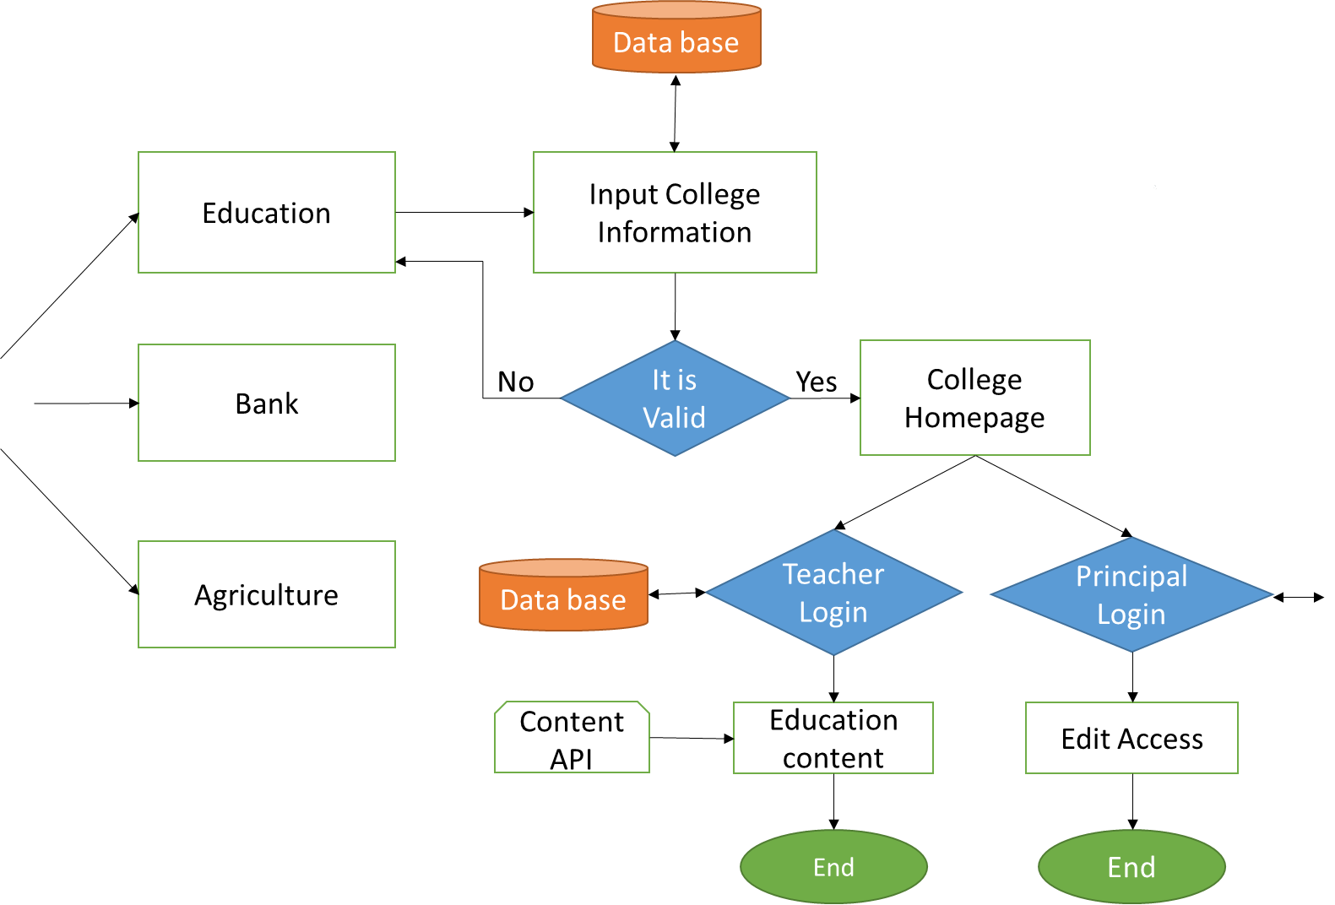


Flowcharts
Technology Stack
HTML
CSS
Java Script
React
Node.js
Express
Tailwind
Mongodb

Slide 4
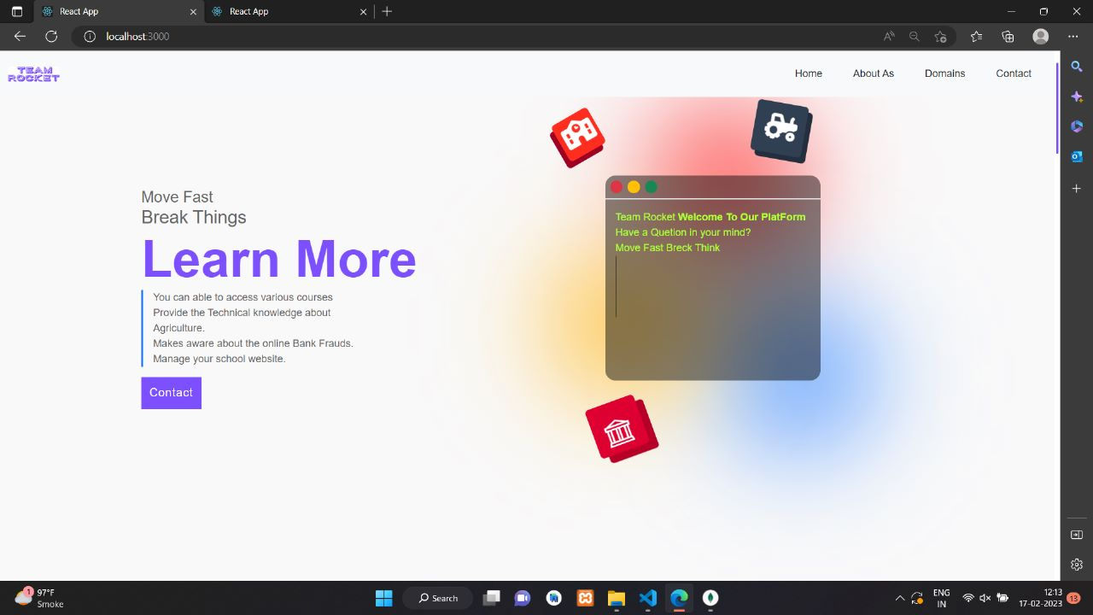
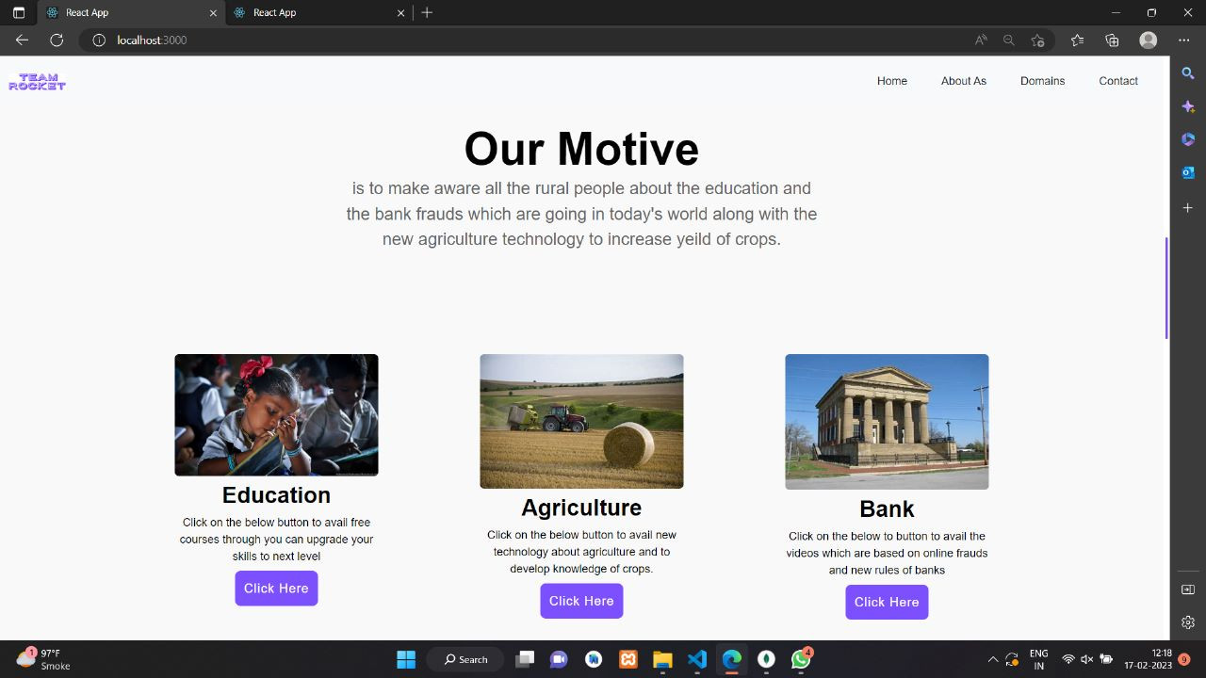
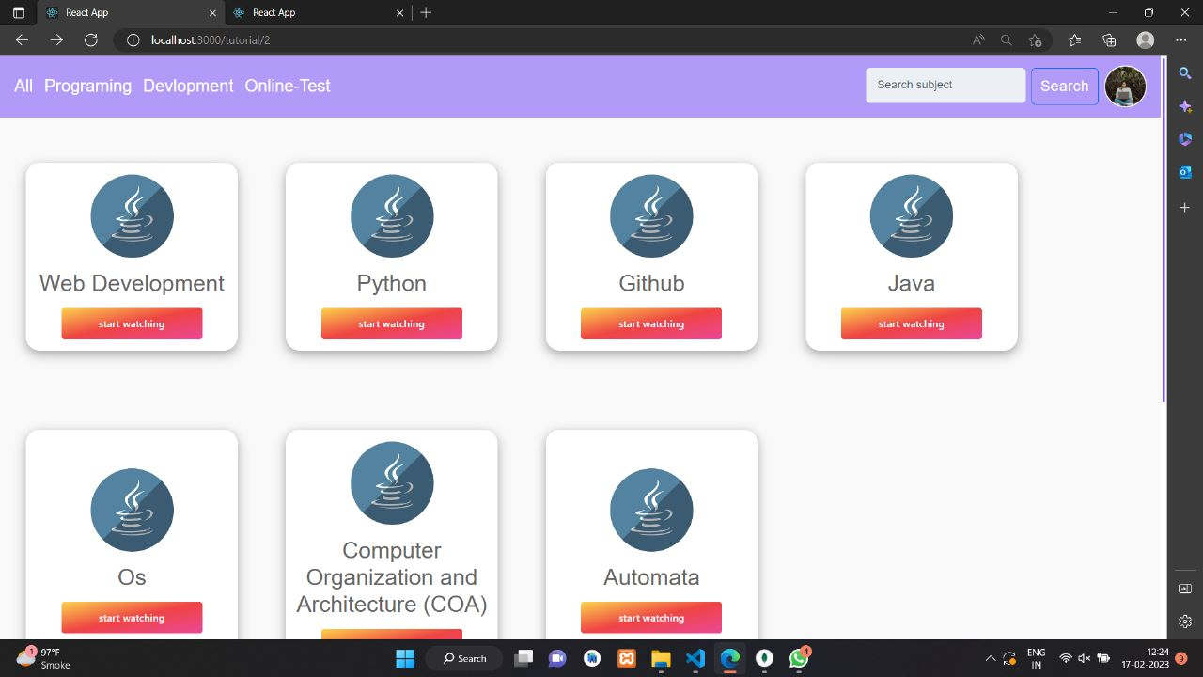
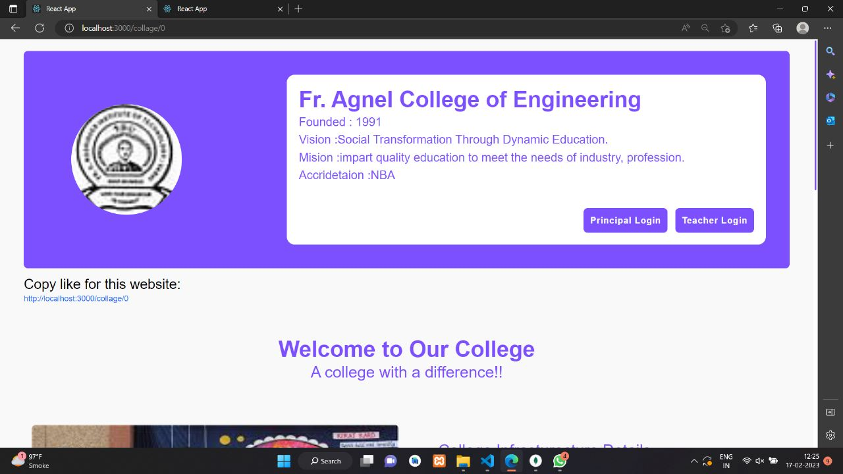
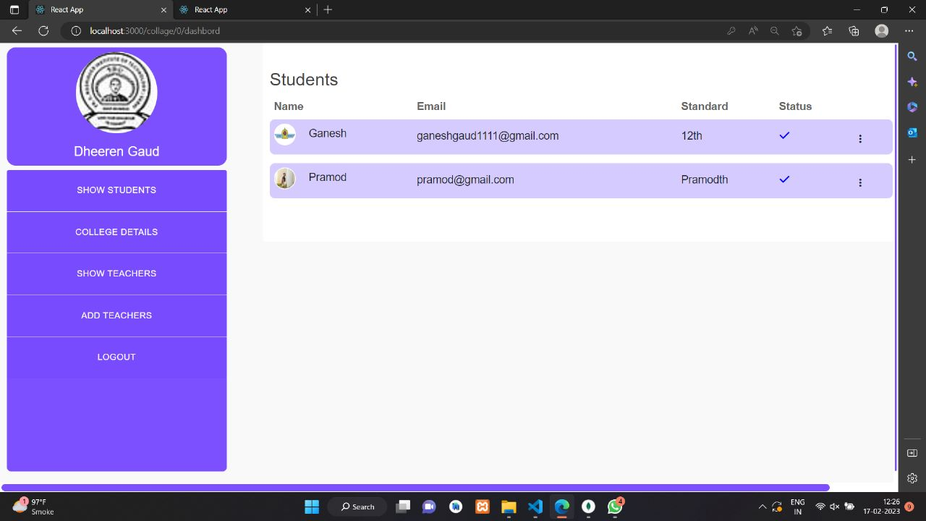
Education

Slide 5
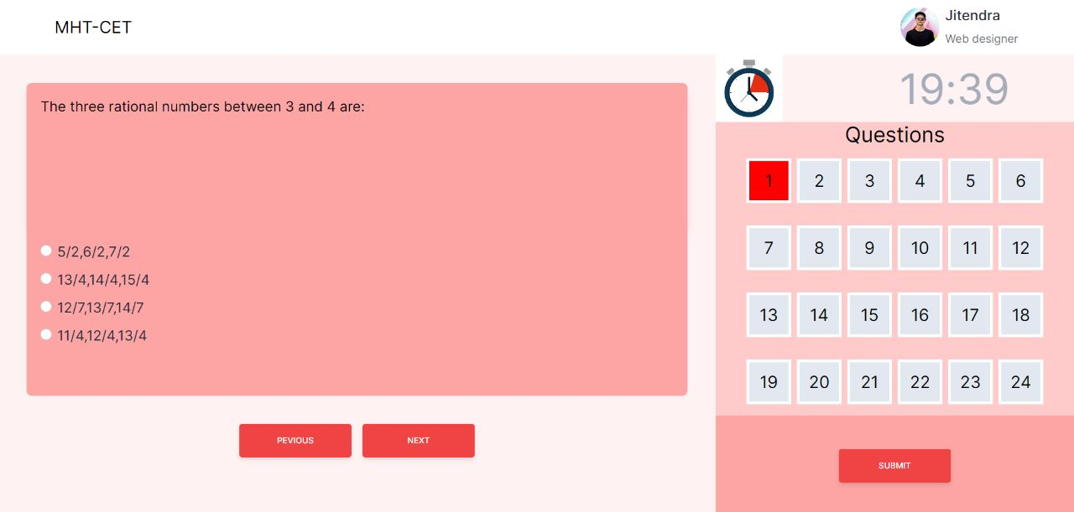
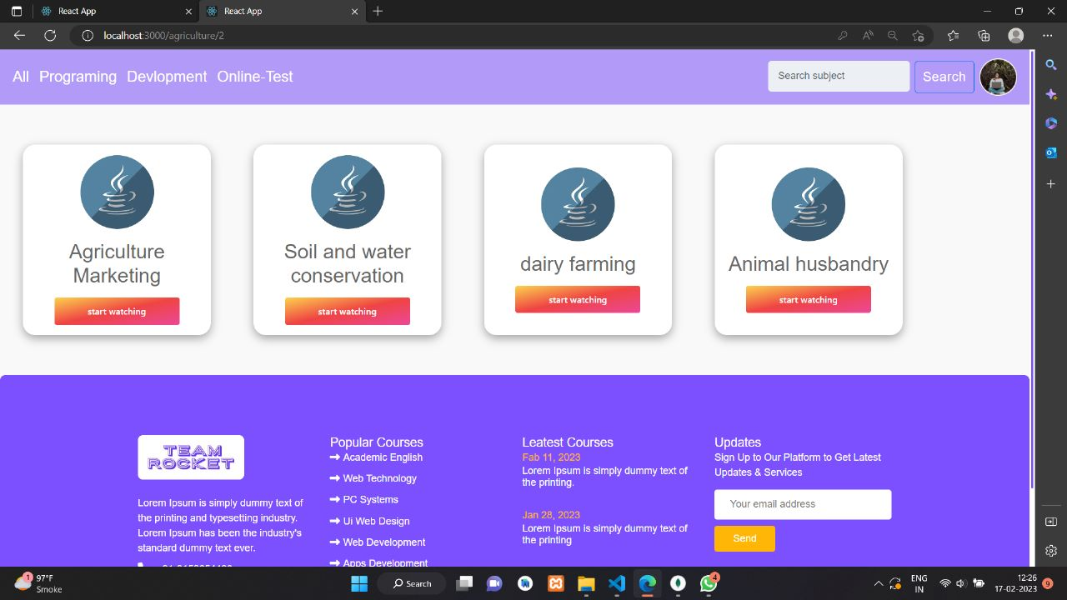
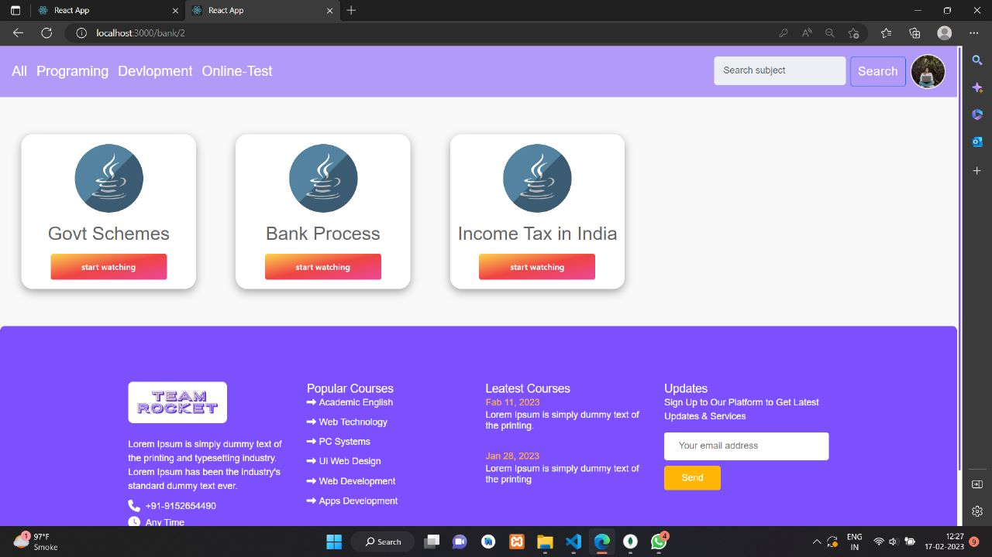
MCQ TEST
Agriculture
Banking

Slide 6
Conclusion:
Social Impact-
By providing access to educational resources such as videos, PDFs, and podcasts, students in rural areas will have access to the same quality of education as those in urban areas. This can help bridge the gap in the education system between rural and urban areas, providing equal opportunities for students to succeed.
In conclusion, the problem of poor quality education in rural India is a major concern and affects the country's literacy rate. Financial difficulties, lack of guidance, and inadequate infrastructure and faculty are the major contributors to this problem. To address these issues, a web app has been proposed as a solution. The app will provide a platform for all rural schools, offer online education and engagement tools, create awareness about government schemes, provide quality education, and teach techniques for improving agricultural production. The app will also help the government track the working of government schools, monitor the qualifications of teachers, and ensure that lectures are conducted properly. With this solution, the quality of education in rural India will improve and help bridge the gap between rural and urban areas in terms of education.

